Slide 1
Amazon Reviews: Unlocked MoBile Phones
Xuanran Ji
IST 736

Slide 2
Outline
Introduction
Goal
Data
Model
Performance
Evaluation
Error Analysis
Conclusion

Slide 3
Introduction
Customer Reviews help customers to learn more about the product and decide whether it is the right product for them before purchase.
Reviews not only have the power to influence consumer decisions but can strengthen a company's credibility. Reviews have the power to gain customer trust and encourage customers to interact with the product company.

Slide 4
Goal
The goal of the project is to classify the review with right rating because customer rating are not 100% accurate. Sometime people accidentally left bad ratings with good reviews and a good rating for a bad review.
Star ratings are integers ranging from one to five that represent how the reviewer likes about the product. Apply text mining for classification task.

Slide 5
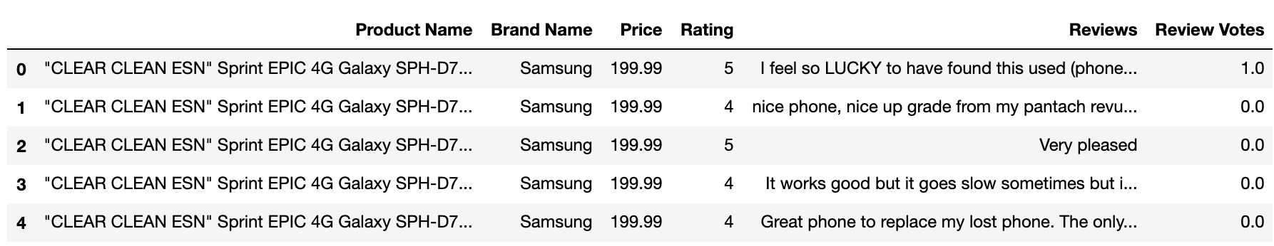
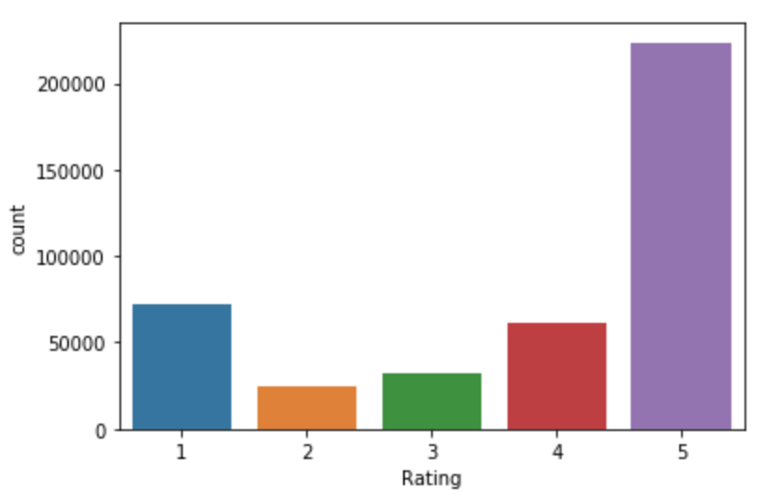
Data
Source: https://www.kaggle.com/PromptCloudHQ/amazon-reviews-unlocked-mobile-phones
413840 rows and 6 columns (information about brand, rating, price, reviews)
Distribution of rating (Data is skewed towards very positive reviews with 5 rating being the most)

Slide 6
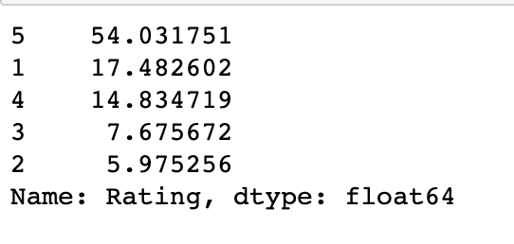
Evaluation Baselines
Data is skewed with more than 50% of reviews being a 5 stars rating.
Using majority vote baseline (54%) since data is skewed

Slide 7
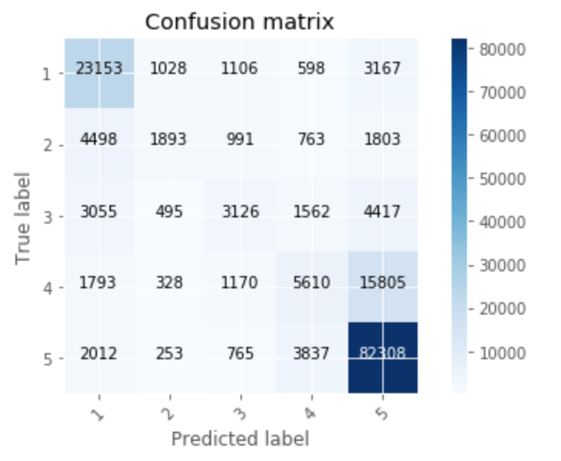


Multinomial Naive Bayes Model
Accuracy score: 0.7012976029383337
Confusion Matrix (1 star rating predicted as 5 star, 5 star predicted to be 1 star)

Slide 8
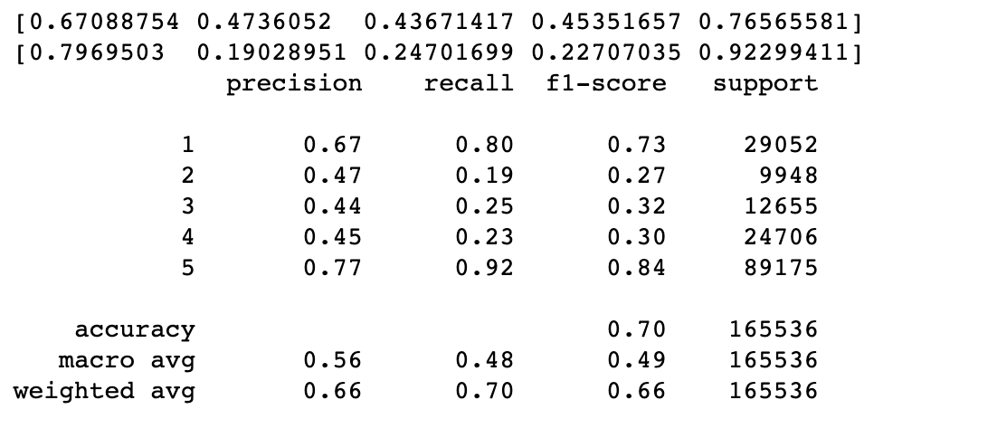

Multinomial Naive Bayes Model
Precision, Recall, and F-Measure support for Imbalanced Classification

Slide 9
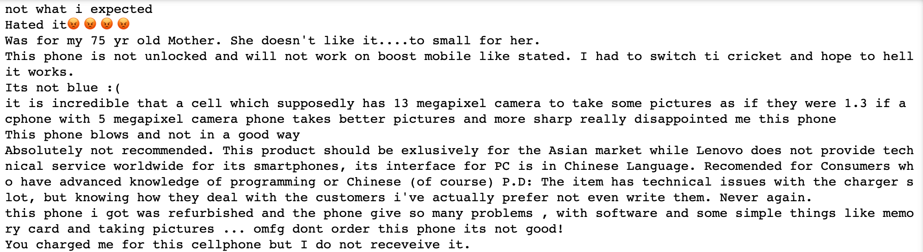
Error ANalysis
Prediction shows error that predict one stars rating as five stars rating
Total error 3167

Slide 10
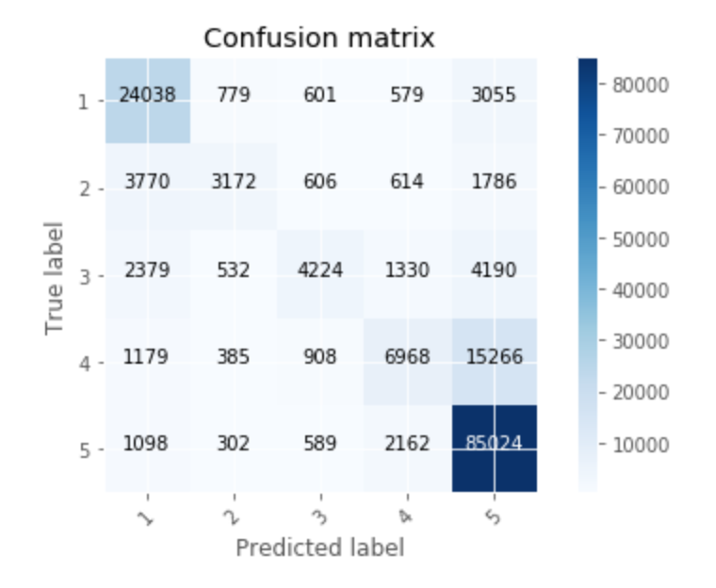


Linear svc Model
Accuracy score: 0.7456142470520007
Confusion Matrix (1 star rating predicted as 5 star, 5 star predicted to be 1 star)

Slide 11
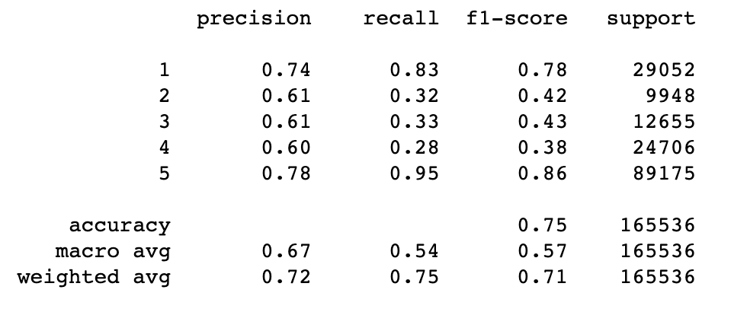
Linear svc model

Slide 12
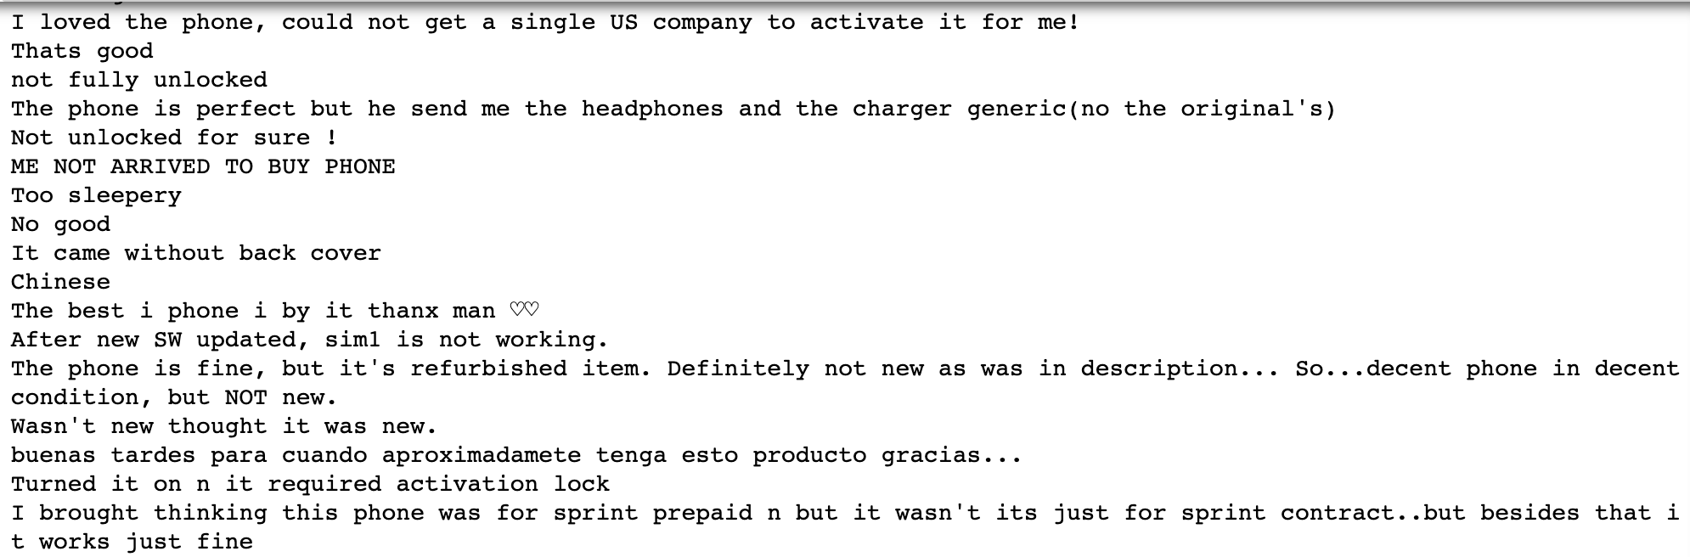
Error analysis
Prediction shows error that predict one stars rating as five stars rating
Total error 3055

Slide 13
Conclusion
In terms of accuracy, linear SVC perform better than Multinomial Naive Bayes Model
Linear SVC perform better prediction for rating other rating
Both model have difficulty to predict negation reviews
Linear SVC model are more flexibility to penalties and loss functions when there are large numbers of samples.

